Slide 1
第10章 统计学习
10.1 概述
10.2 几种基本判别模型的学习
10.3 监督学习中几个进一步的问题
10.4 支持向量机简介
教学目标：理解统计学习基本原理、方法和分类;掌握线性回归和Logistic回归模型学习
重点与难点：统计学习基本原理及分类； 回归问题的线性函数模型学习和梯度下降法、分类问题的线性判别函数模型学习。
学时：4小时

Slide 2
10.1 概述
让计算机（机器）执行以统计、概率和其他数学理论为基础的算法，处理相关样本数据以发现其中的模式或规律的“机器学习”方法——统计机器学习，即统计学习（Statistical Learning）。
统计学习的主要工作和过程是：首先准备样本数据，然后针对样本数据的特点，选择或设计某种数值模型或概率模型、准则函数（criterion function）（如误差、损失、代价、风险函数等）、学习策略和算法，最后编程实现以归纳或估算一个最优模型。

Slide 3
统计学习的主要任务是发现或估计隐藏于样本数据中的类别关系、函数关系或模式（类）以解决相关的分类（classification）、回归（regression）或聚类（clustering）等问题。这样，统计学习又可分为面向分类的学习、面向回归的学习和面向聚类的学习等。
其中，面向分类的学习又大体有两条技术路线：一条是数值路线，另一条是概率路线。
一般来讲，数值路线的学习结果是问题的近似解，而概率路线的学习结果是可能解。

Slide 4
面向回归的学习与面向分类的学习的数据形式是相似的，只是其数据对中的响应值（也称输出值）一般是实数，而不是分类学习中的类别标记。所以，回归学习的模型、约束、策略、算法等与数值路线的分类学习既相似又有区别。
聚类学习面向无响应值的数据，其目标是发现数据所表征的类别模式。聚类学习也有许多经典算法，如k-均值算法、期望最大化算法、谱聚类算法和层次聚类算法等等。

Slide 5
统计学习是一种基于样本数据的学习，而样本数据一般是n维向量（称为特征向量）或者n维向量与符号或数值组成的序对，所以统计学习的方法主要是监督学习和无监督学习。
决策树学习是一种独特的监督学习方法，它不仅可用于符号学习，也可用于统计学习。在统计学习中，它既可用于分类学习也可用于回归学习；它既可走数值路线，也可走概率路线。

Slide 6

What is machine learning
Introduction
Machine Learning

Slide 7
机器学习（Machine Learning）
Grew out of work in AI
New capability for computers
Examples:
数据库挖掘 （Database mining ）
Large datasets from growth of automation/web.
E.g., Web click data, medical records, biology, engineering
Applications can’t program by hand.
E.g., Autonomous helicopter, handwriting recognition, most of Natural Language Processing (NLP), Computer Vision.
Self-customizing programs
E.g., Amazon, Netflix product recommendations
Understanding human learning (brain, real AI).

Slide 8

机器学习的定义
Arthur Samuel (1959). Machine Learning: Field of study that gives computers the ability to learn without being explicitly programmed.
Tom Mitchell (1998) Well-posed Learning Problem: A computer program is said to learn from experience E with respect to some task T and some performance measure P, if its performance on T, as measured by P, improves with experience E.
Machine Learning <T,P,E>:
Computer automatically improves
at task T(任务)
according to performance metric P(性能)
through experience E(经验)

Slide 9
Examples of the Learning Tasks
Playing checkers
T: Playing checkers
P: Percentage of games won against an arbitrary opponent
E: Playing practice games against itself
Recognizing
T: Recognizing hand-written words
P: Percentage of words correctly classified
E: Database of human-labeled images of handwritten words
Automatically driving
T: Driving on four-lane highways using vision sensors
P: Average distance traveled before a human-judged error
E: A sequence of images and steering commands recorded while observing a human driver.

Slide 10
Machine learning algorithms:
监督学习(Supervised learning)
非监督学习(Unsupervised learning)
Others: 强化学习(Reinforcement learning), 推荐系统(recommender systems).

Slide 11
Supervised Learning
Introduction
Machine Learning

Slide 12
房价预测
Price ($)
in 1000’s
Size in feet²
监督学习Supervised Learning
“right answers” given
回归Regression: Predict continuous valued output (price)

Slide 13
Breast cancer (恶性, 良性)
分类Classification
Discrete valued output (0 or 1)
1(Y)
恶性?
0(N)
肿瘤大小
肿瘤大小

Slide 14
Clump Thickness
Uniformity of Cell Size
Uniformity of Cell Shape
…
_{年龄}
_{肿瘤大小}

Slide 15
You’re running a company, and you want to develop learning algorithms to address each of two problems.
Problem 1: You have a large inventory of identical items. You want to predict how many of these items will sell over the next 3 months.
Problem 2: You’d like software to examine individual customer accounts, and for each account decide if it has been hacked.
这些问题是分类问题还是回归问题?
Treat both as classification problems.
Treat problem 1 as a regression problem, problem 2 as a classification problem.
Treat both as regression problems.
Treat problem 1 as a classification problem, problem 2 as a regression problem.
Notes:
/compromised

Slide 16
非监督学习Unsupervised Learning
Introduction
Machine Learning

Slide 17
监督学习Supervised Learning
x₂
x₁

Slide 18
非监督学习Unsupervised Learning
x₂
x₁

Slide 19



Slide 20

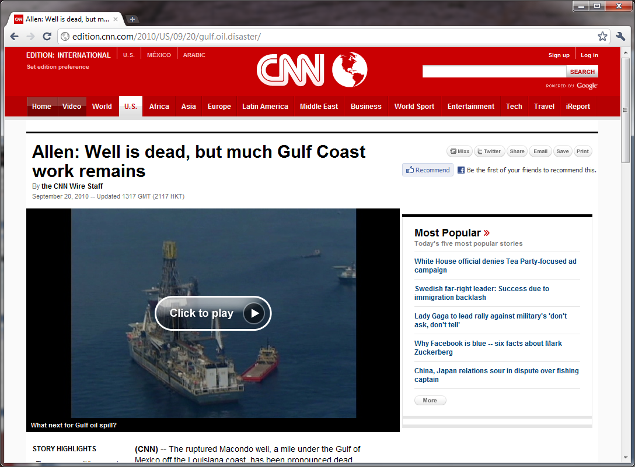
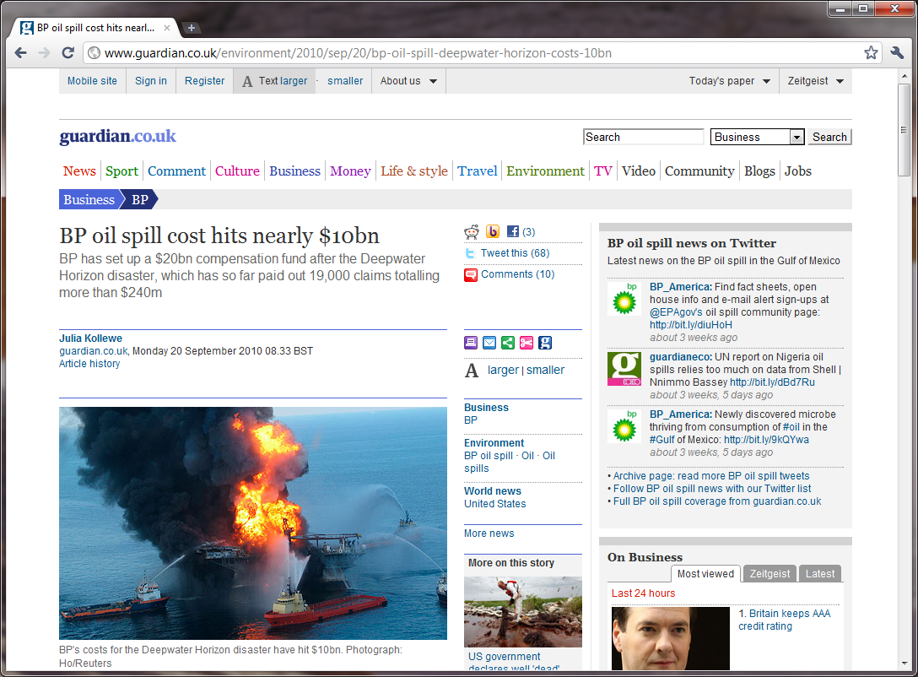

Slide 21

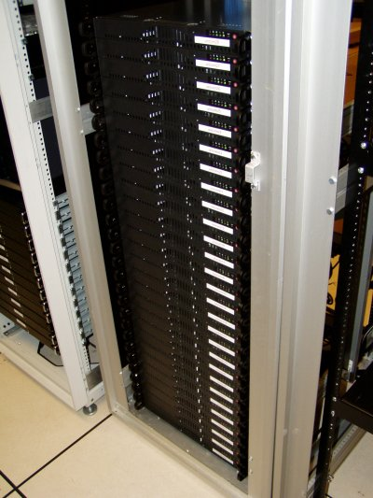
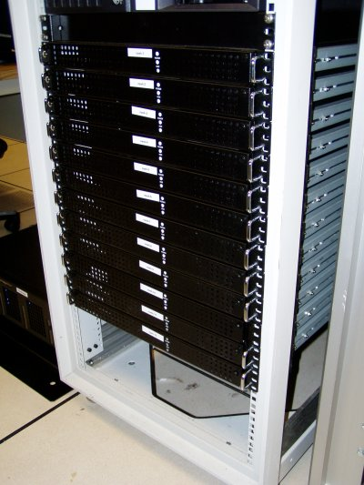

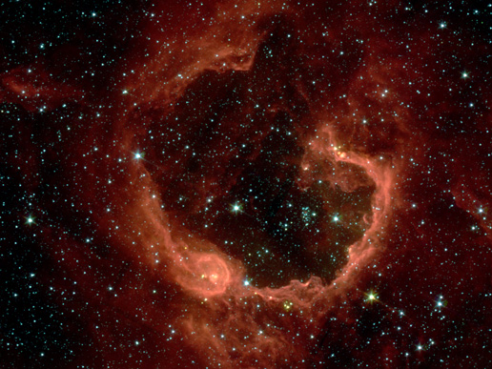
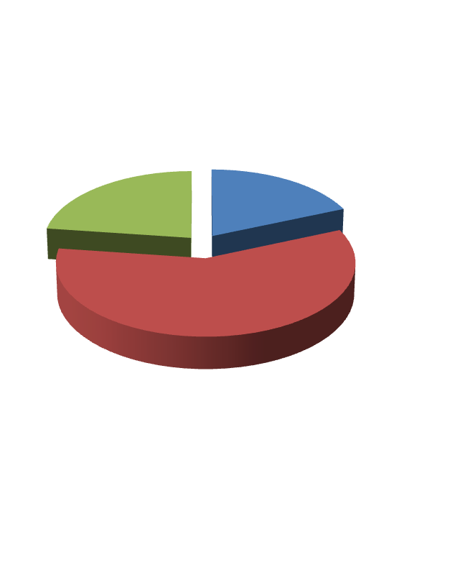
Organize computing clusters
Social network analysis
Image credit: NASA/JPL-Caltech/E. Churchwell (Univ. of Wisconsin, Madison)
Market segmentation
Astronomical data analysis
Notes:
Astronomical data analysis image obtained from NASA website.
http://www.nasa.gov/multimedia/imagegallery/image_feature_874.html
RCW 79 is seen in the southern Milky Way, 17,200 light-years from Earth in the constellation Centaurus. The bubble is 70-light years in diameter, and probably took about one million years to form from the radiation and winds of hot young stars. The balloon of gas and dust is an example of stimulated star formation. Such stars are born when the hot bubble expands into the interstellar gas and dust around it. RCW 79 has spawned at least two groups of new stars along the edge of the large bubble. Some are visible inside the small bubble in the lower left corner. Another group of baby stars appears near the opening at the top. NASA's Spitzer Space Telescope easily detects infrared light from the dust particles in RCW 79. The young stars within RCW79 radiate ultraviolet light that excites molecules of dust within the bubble. This causes the dust grains to emit infrared light that is detected by Spitzer and seen here as the extended red features. Image credit: NASA/JPL-Caltech/E. Churchwell (Univ. of Wisconsin, Madison)
--------------------
From NASA use guidelines:
http://www.nasa.gov/multimedia/guidelines/index.html
Using NASA Imagery and Linking to NASA Web Sites 10.13.05 Still Images, Audio Files and Video
NASA still images, audio files and video generally are not copyrighted. You may use NASA imagery, video and audio material for educational or informational purposes, including photo collections, textbooks, public exhibits and Internet Web pages. This general permission extends to personal Web pages.
This general permission does not extend to use of the NASA insignia logo (the blue "meatball" insignia), the retired NASA logotype (the red "worm" logo) and the NASA seal. These images may not be used by persons who are not NASA employees or on products (including Web pages) that are not NASA sponsored.
If the NASA material is to be used for commercial purposes, especially including advertisements, it must not explicitly or implicitly convey NASA's endorsement of commercial goods or services. If a NASA image includes an identifiable person, using the image for commercial purposes may infringe that person's right of privacy or publicity, and permission should be obtained from the person. Any questions regarding application of any NASA image or emblem should be directed to:
Photo Department NASA Headquarters 300 E St. SW Washington, DC 20546 Tel: (202)358-1900 Fax: (202)358-4333
Linking to NASA Web Sites
NASA Web sites are not copyrighted, and may be linked to from other Web sites, including individuals' personal Web sites, without explicit permission from NASA. However, such links may not explicitly or implicitly convey NASA's endorsement of commercial goods or services.
NASA images may be used as graphic "hot links" to NASA Web sites, provided they are used within the guidelines above. This permission does not extend to use of the NASA insignia, the retired NASA logotype or the NASA seal.
Restrictions
Please be advised that:
1) NASA does not endorse or sponsor any commercial product, service, or activity.
2) The use of the NASA name, initials, any NASA emblems (including the NASA insignia, the NASA logo and the NASA seal) which would express or imply such endorsement or sponsorship is strictly prohibited.
3) Use of the NASA name or initials as an identifying symbol by organizations other than NASA (such as on foods, packaging, containers, signs, or any promotional material) is prohibited.
4) NASA does permit the use of the NASA logo and insignia on novelty and souvenir-type items. However, such items may be sold and manufactured only after a proposal has been submitted to and approved by a Visual Identity representative from the Public Outreach Division (Phone: 202/358-1750) in accordance with 14 CFR (Code of Federal Regulations) Part 1221. Permission is granted on a nonexclusive basis as it is not NASA's policy to grant exclusive rights to use any of the agency identities.
5) No approval for use is authorized by NASA when the use can be construed as an endorsement by NASA of a product, service or activity.
6) NASA emblems should be reproduced only from original reproduction proofs, transparencies, or computer files available from NASA Headquarters. Please be advised that approval must be granted by a Visual Identity representative from the Public Outreach Division ( Tel: 202/358-1750) before any reproduction materials can be obtained.

Slide 22
下面例子中，你认为哪些可以使用非监督学习算法来解决？
给定标记了垃圾/非垃圾的电子邮件, 训练学习一个垃圾邮件分类器程序.
给定网页上的一堆新闻，按照主题相似性对它们进行分组
给定一个用户数据库，自动地发现市场划分，将这些顾客划分到不同的市场划分组中。
给定一个已被诊断为糖尿病/非糖尿病病人数据库, 学习将新病人分类为糖尿病/非糖尿病.

Slide 23
回顾：
统计学习的基本原理
统计学习的分类

Slide 24
教学重点： 模型表示、代价函数、梯度下降算法、多变量线性回归 教学难点：梯度下降
线性回归
Machine Learning
机器学习

Slide 25
模型表示
线性回归（ 单个变量）
Machine Learning
机器学习

Slide 26
住房价格
Housing Prices
(Portland, OR)
Price
(in 1000s of dollars)
Size (feet²)
监督学习Supervised Learning
为数据中的每个样本给定“正确答案”Given the “right answer” for each example in the data.
回归问题Regression Problem
预测实值的输出
Predict real-valued output

Slide 27
房价的训练集
Training set of
housing prices
(Portland, OR)
大小Size in feet² (x) | 价格Price ($) in 1000's (y)
2104 | 460
1416 | 232
1534 | 315
852 | 178
… | …
定义Notation:
m = Number of training examples 训练样本数
x’s = “input” variable / features “输入”变量/特征
y’s = “output” variable / “target” variable “输出”/“目标”变量

Slide 28
Training Set训练集
How do we represent h
如何表示假设函数h?
Learning Algorithm
学习算法
房子
大小
h
估计的
价格
Linear regression with one variable.
Univariate linear regression.
单变量线性回归

Slide 29
代价函数 Cost function
单变量线性回归
Machine Learning

Slide 30
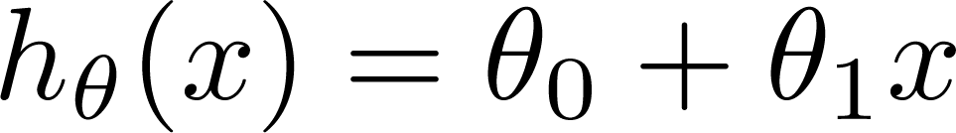

Training Set
训练集
Size in feet² (x) | Price ($) in 1000's (y)
2104 | 460
1416 | 232
1534 | 315
852 | 178
… | …
Hypothesis假设:
‘s: Parameters参数
How to choose ‘s ?

Slide 31
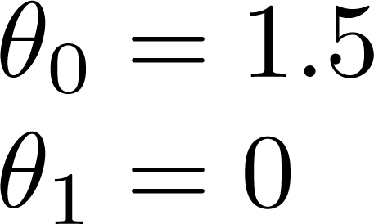
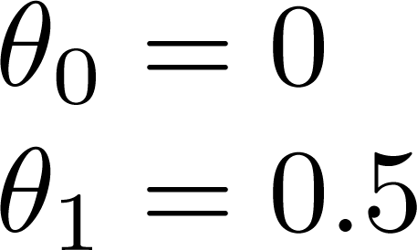
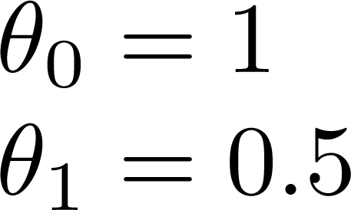

Slide 32
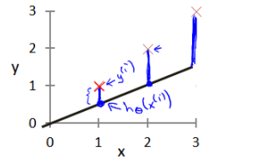
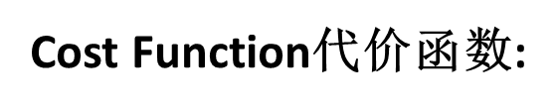
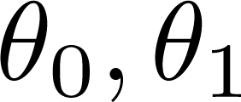


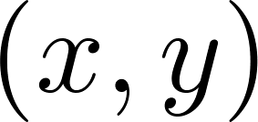
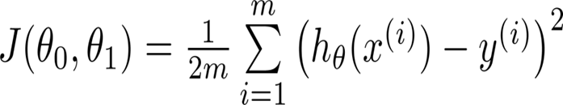
y
x
建模误差（modeling error）
Idea: Choose so that is close to for our training examples
目标：建模误差的平方和能够最小的模型

Slide 33
代价函数I Cost function intuition I
单变量线性回归
Linear regression with one variable
Machine Learning

Slide 34
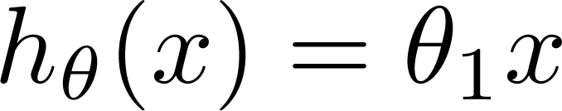

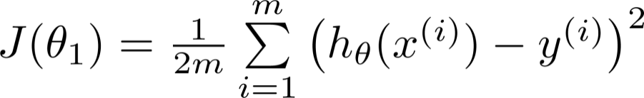
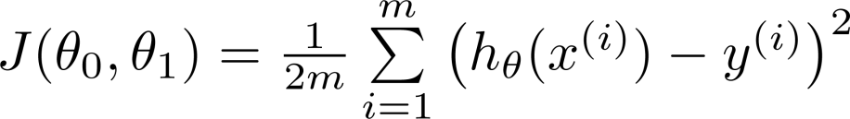
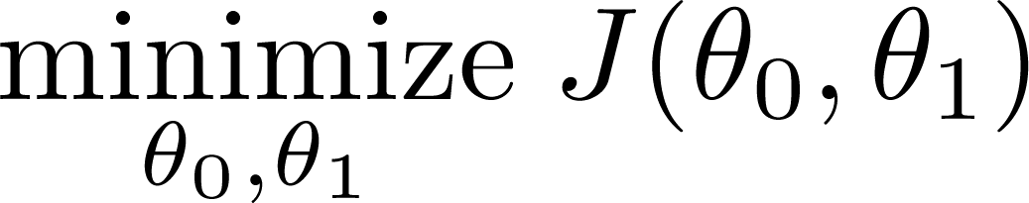
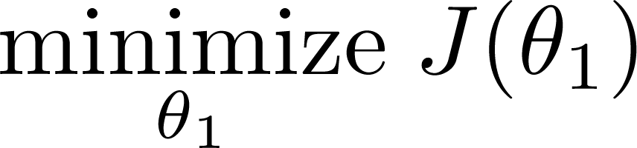
Simplified简化
Hypothesis假设:
Parameters参数:
Cost Function代价函数:
Goal目标:

Slide 35
Simplified简化
Hypothesis假设:
Parameters参数:
Cost Function代价函数:
Goal目标:

Slide 36






(for fixed , this is a function of x)
(function of the parameter )
y
x

Slide 37
(for fixed , this is a function of x)
(function of the parameter )
y
x

Slide 38


(for fixed , this is a function of x)
(function of the parameter )
y
x

Slide 39
(for fixed , this is a function of x)
(function of the parameter )
y
x

Slide 40

(for fixed , this is a function of x)
(function of the parameter )
y
x

Slide 41
(for fixed , this is a function of x)
(function of the parameter )
y
x

Slide 42
(for fixed , this is a function of x)
(function of the parameter )
y
x

Slide 43
(for fixed , this is a function of x)
(function of the parameter )
y
x

Slide 44
代价函数II Cost function intuition I
单变量线性回归
Linear regression with one variable
Machine Learning

Slide 45
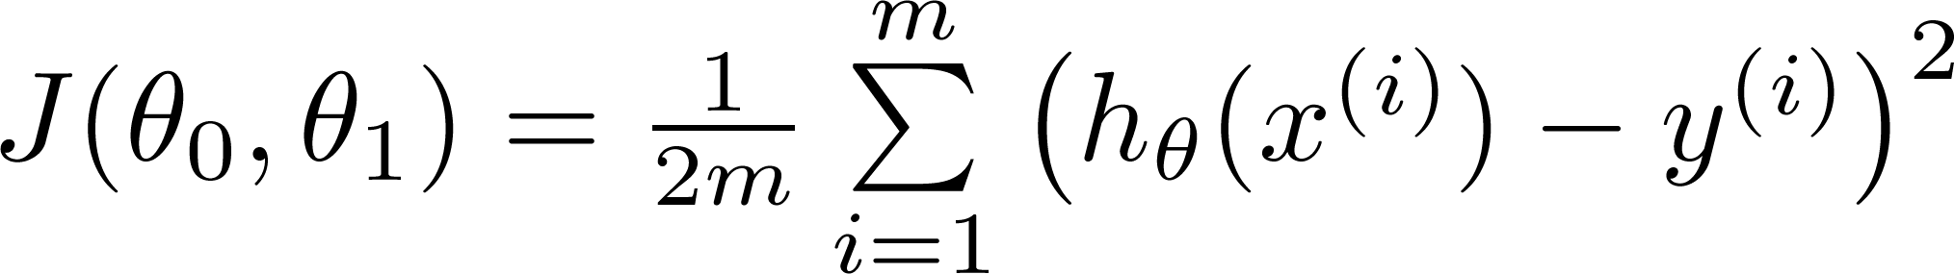
假设
(Hypothesis):
Parameters参数:
Cost Function
代价函数:
Goal目标:

Slide 46
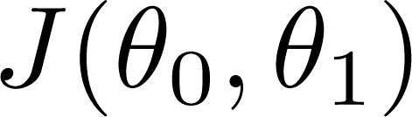


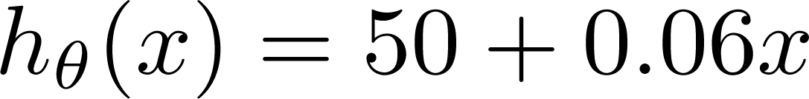
假设
代价函数
(for fixed , this is a function of x)
(function of the parameters )
Price ($)
in 1000’s
Size in feet² (x)
假设函数的截距参数θ₀不为零？

Slide 47
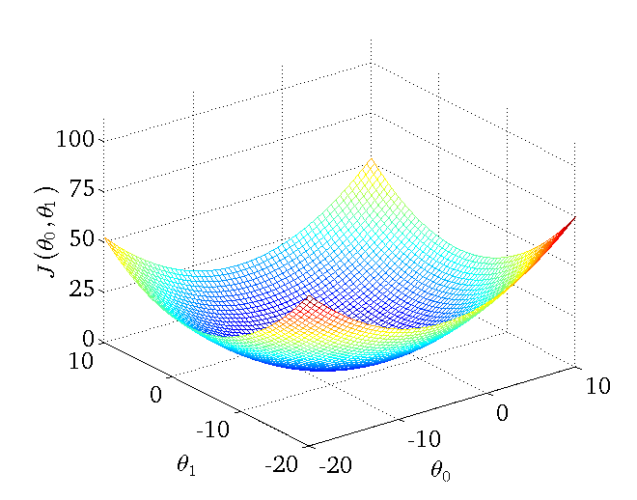
等高线图

Slide 48
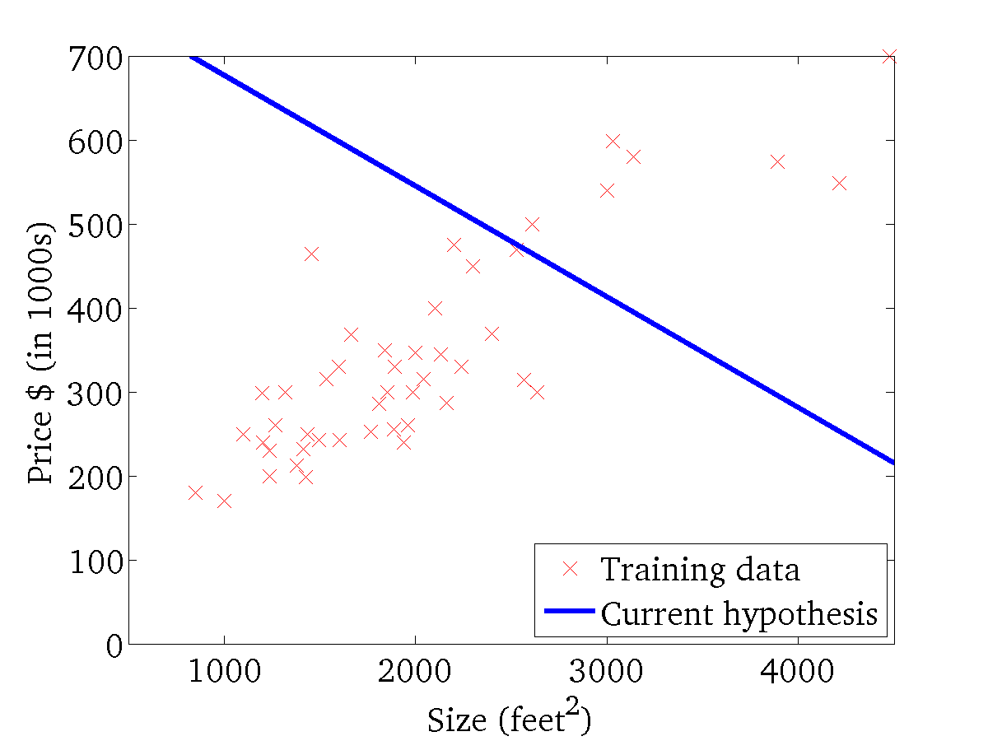
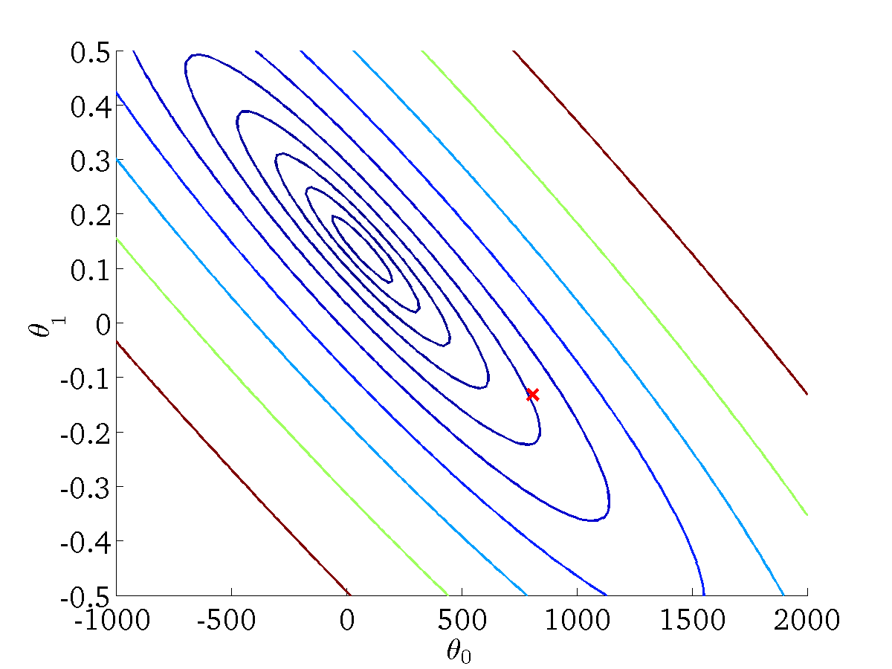
(for fixed , this is a function of x)
(function of the parameters )

Slide 49
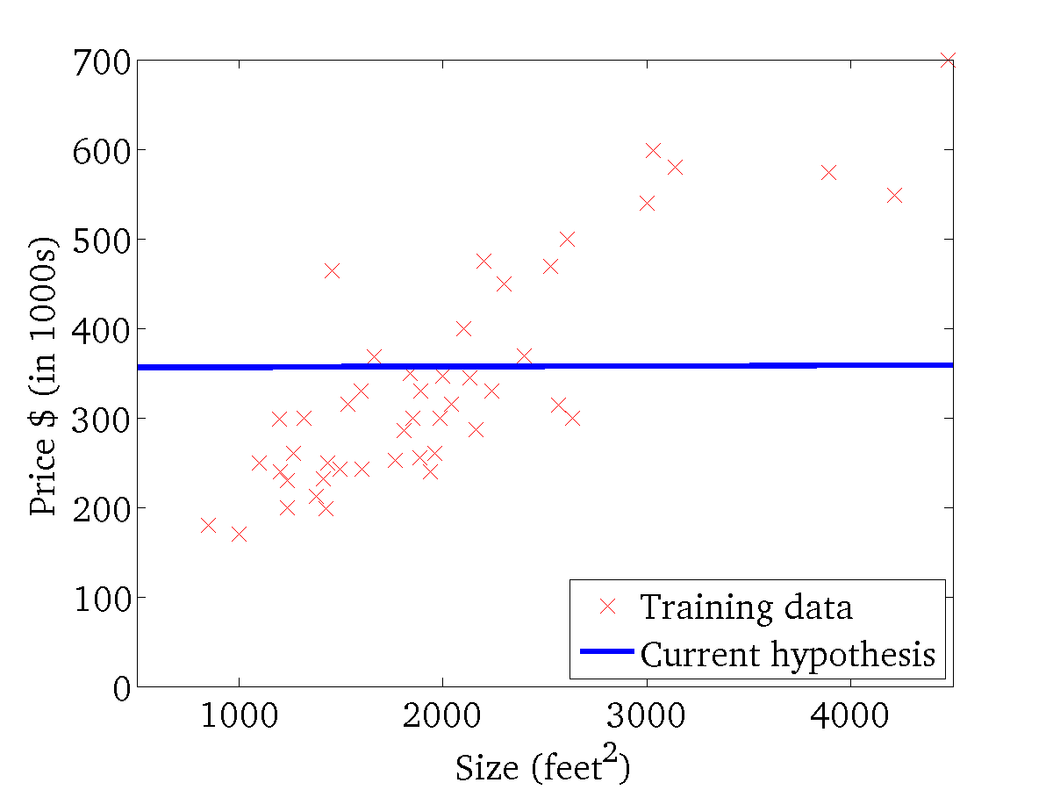
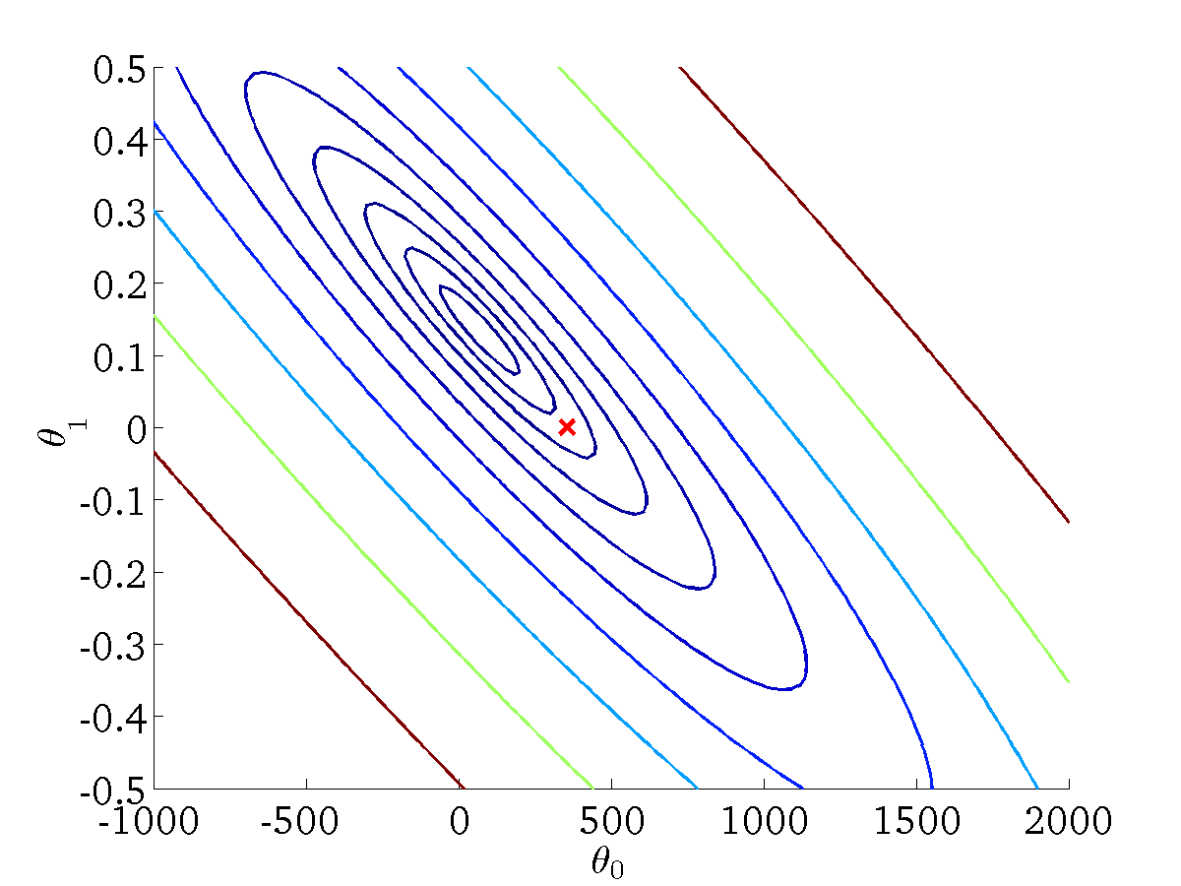
(for fixed , this is a function of x)
(function of the parameters )

Slide 50
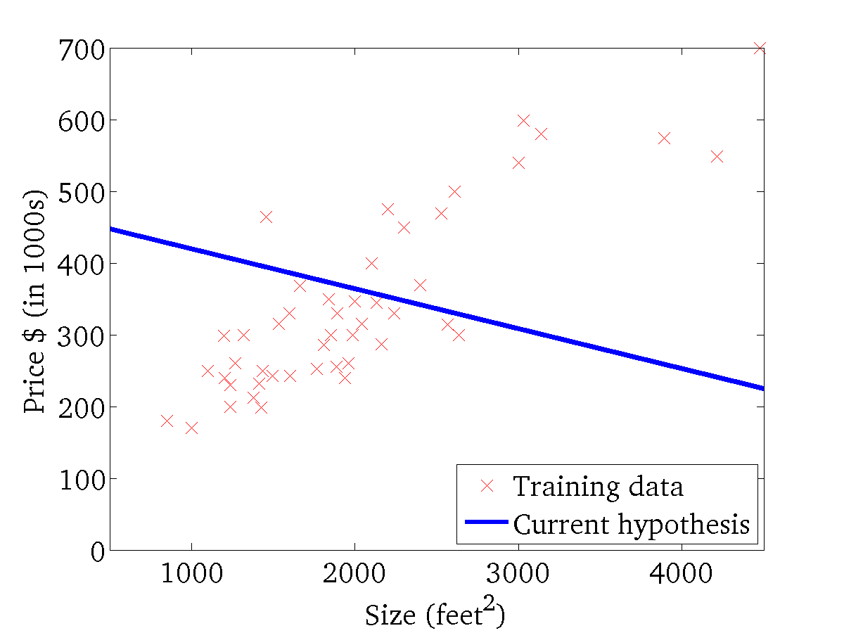

(for fixed , this is a function of x)
(function of the parameters )

Slide 51
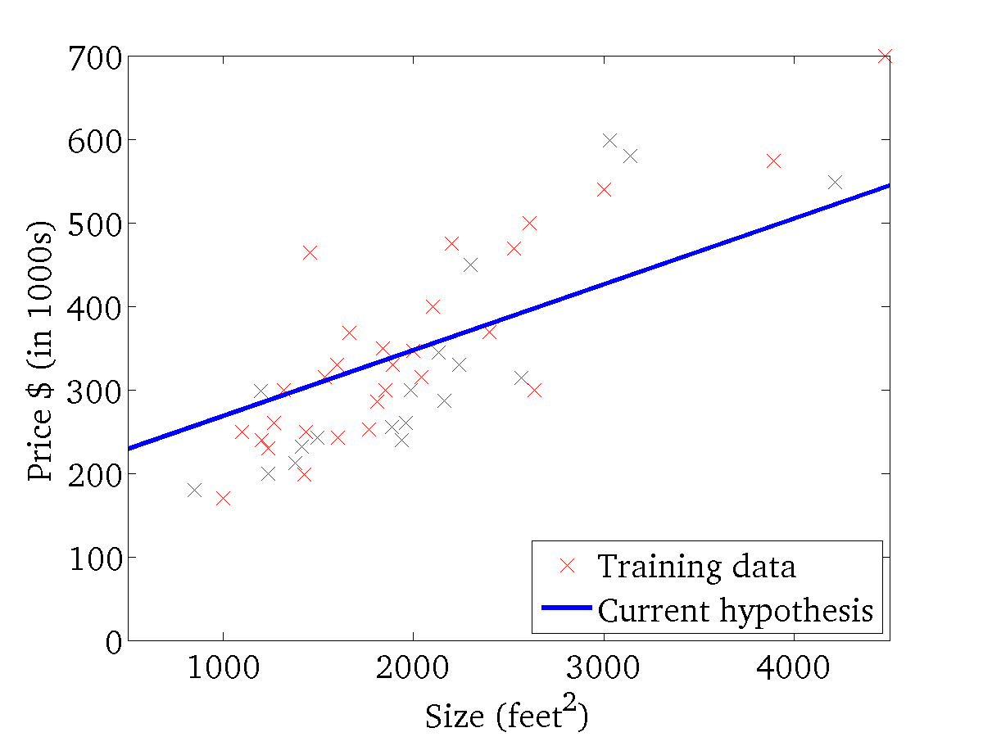
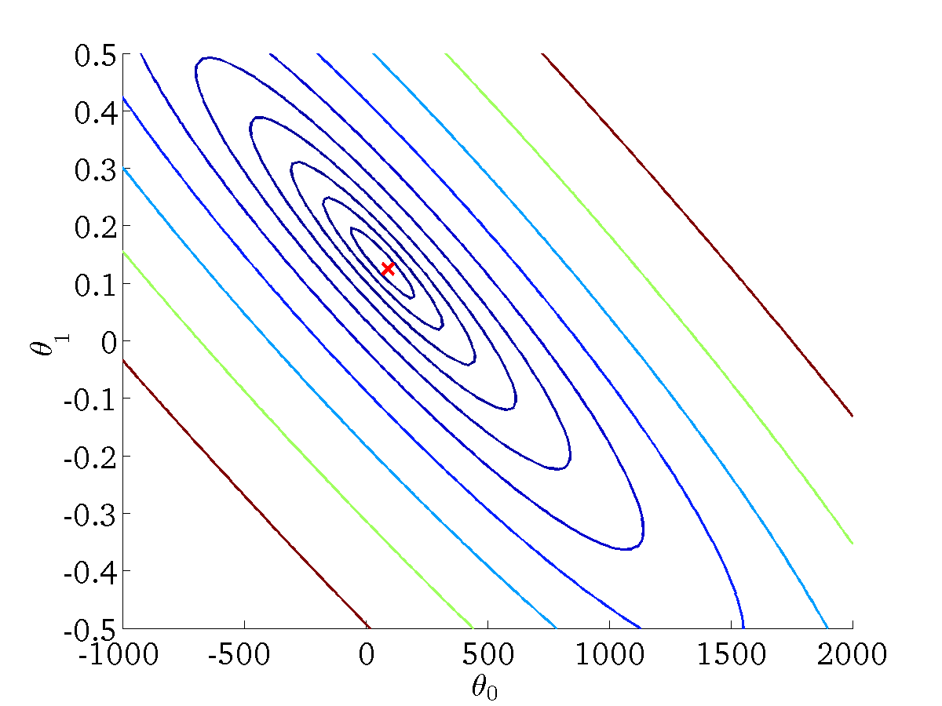
(for fixed , this is a function of x)
(function of the parameters )

Slide 52
梯度下降Gradient descent
单变量线性回归
Machine Learning

Slide 53
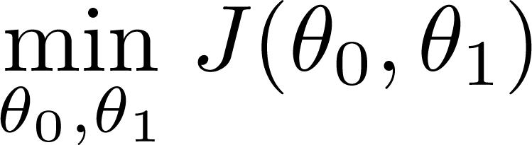
已有代价函数
需要
Outline概要:
Start with some
Keep changing to reduce until we hopefully end up at a minimum最小值

Slide 54
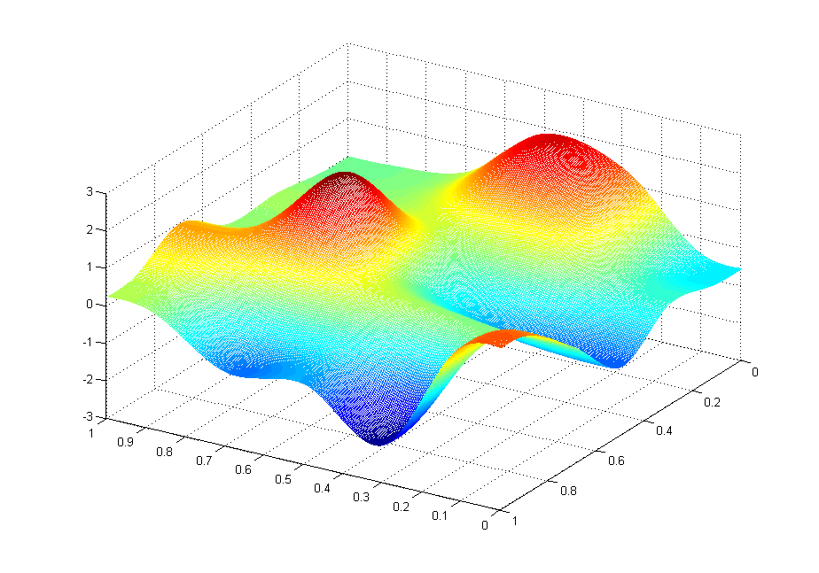
J(θ₀,θ₁)
θ₁
θ₀

Slide 55
J(θ₀,θ₁)
θ₁
θ₀

Slide 56
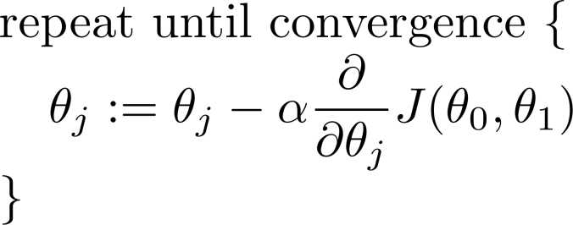
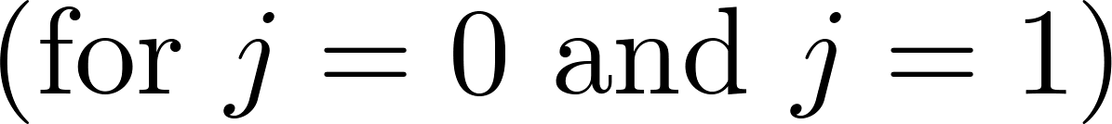
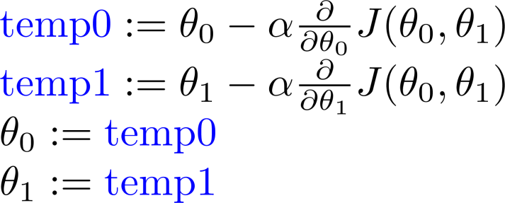
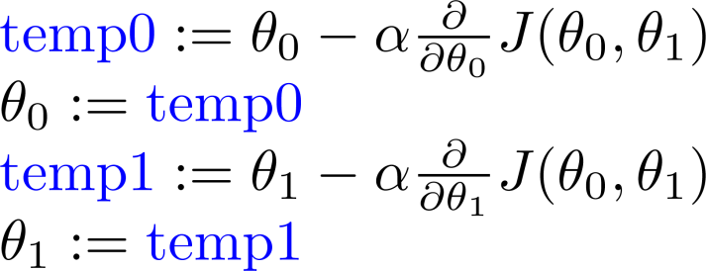
梯度下降算法 Gradient descent algorithm
Correct: 同时更新
Incorrect:

Slide 57
梯度下降Gradient descent intuition
单变量线性回归
Machine Learning

Slide 58
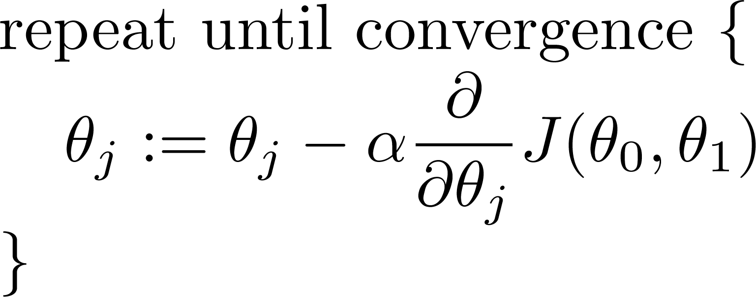
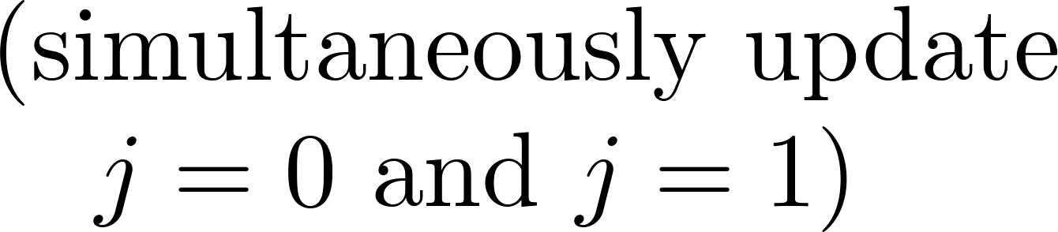
Gradient descent algorithm梯度下降算法
同时更新

Slide 60
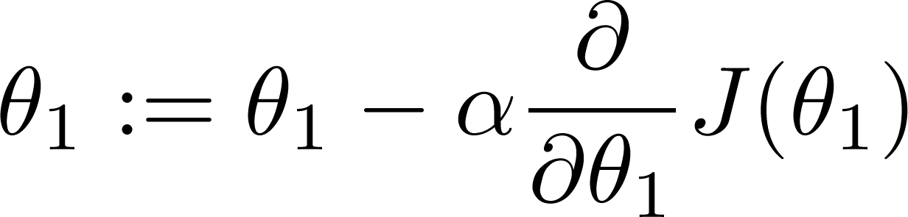
If α is too small, gradient descent can be slow.
If α is too large, gradient descent can overshoot the minimum. It may fail to converge, or even diverge.

Slide 61

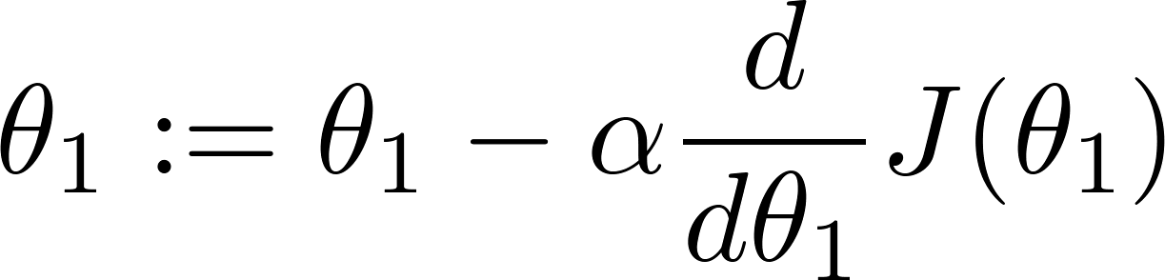
at local optima
Current value of

Slide 62
梯度下降可以收敛到局部极小值,即使以一个固定的学习率α.
As we approach a local minimum, gradient descent will automatically take smaller steps. So, no need to decrease α over time.

Slide 63
Gradient descent for linear regression
单变量线性回归
Machine Learning

Slide 64
假设
(Hypothesis):
Parameters参数:
Cost Function
代价函数:
Goal目标:

Slide 65
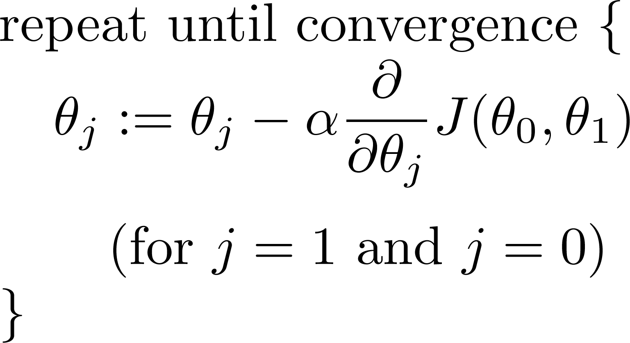
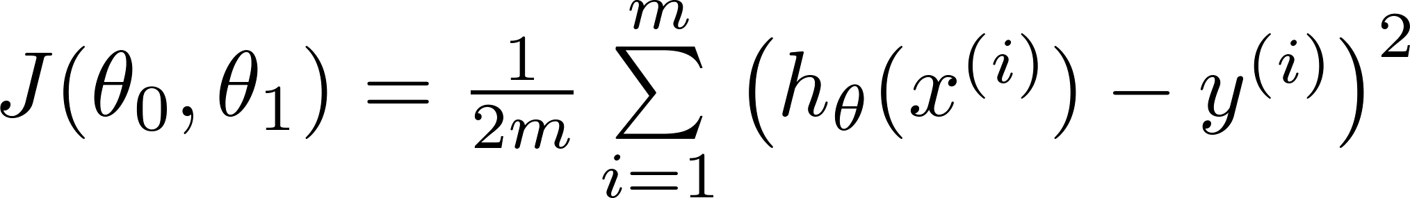
Gradient descent algorithm
Linear Regression Model

Slide 66
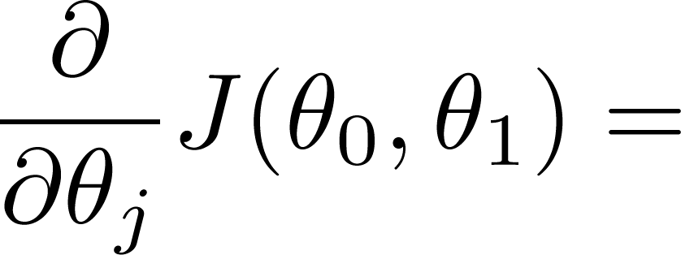
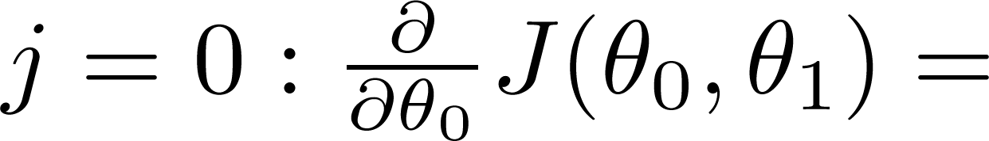
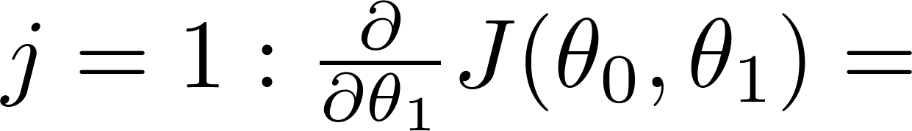

Slide 67
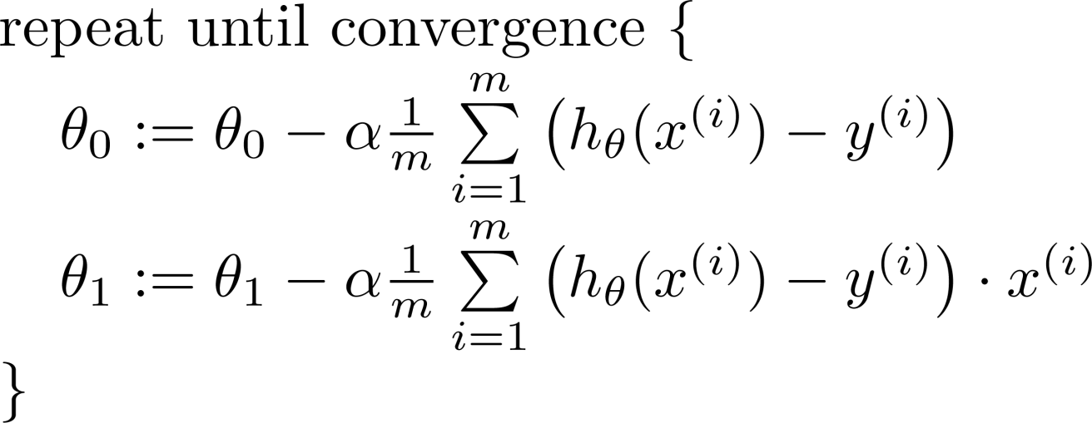

Gradient descent algorithm
update
and
simultaneously

Slide 68
J(θ₀,θ₁)
θ₁
θ₀

Slide 69
J(θ₀,θ₁)
θ₁
θ₀

Slide 71
“Batch” Gradient Descent
“Batch”: Each step of gradient descent uses all the training examples.
例：房价预测：ex1.m

Slide 72
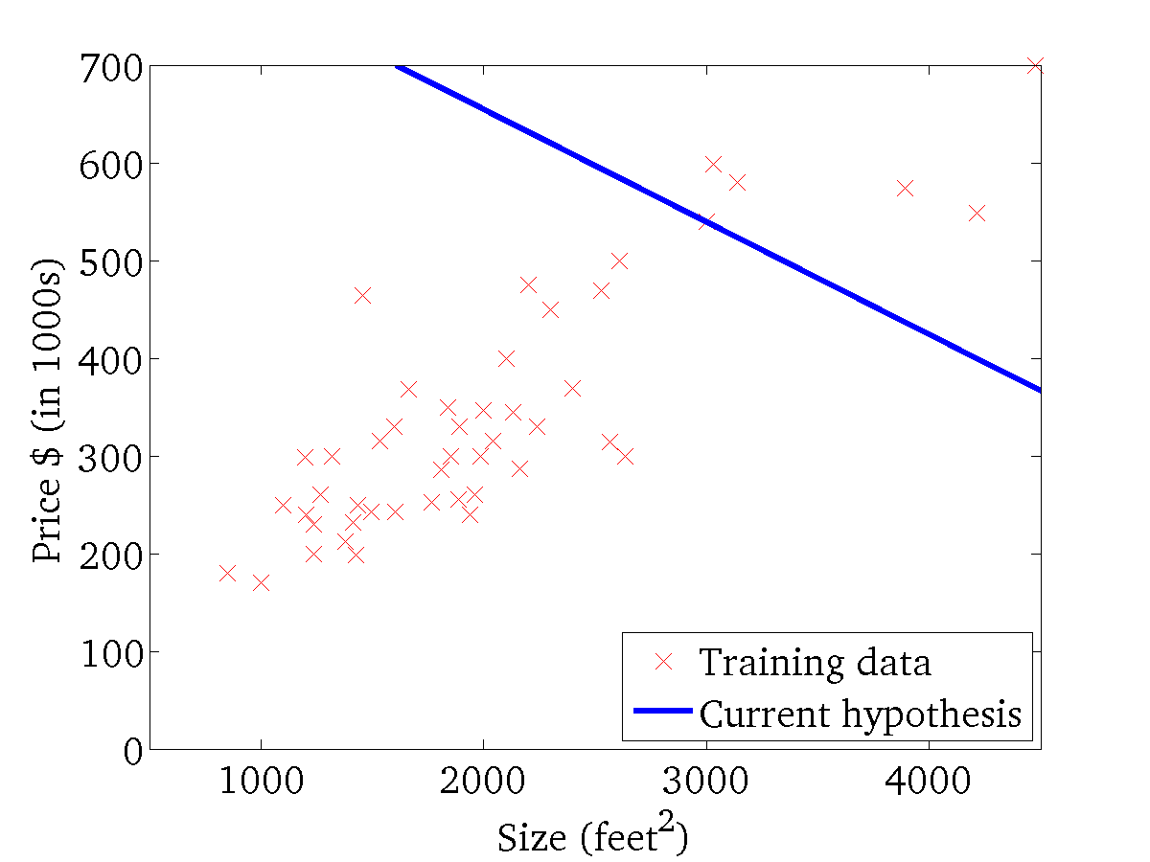
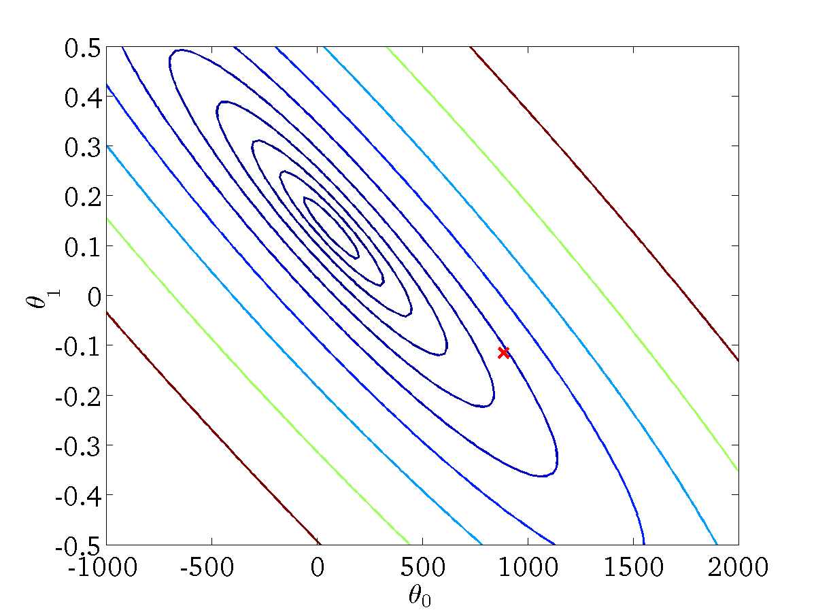
(for fixed , this is a function of x)
(function of the parameters )

Slide 73

(for fixed , this is a function of x)
(function of the parameters )

Slide 74
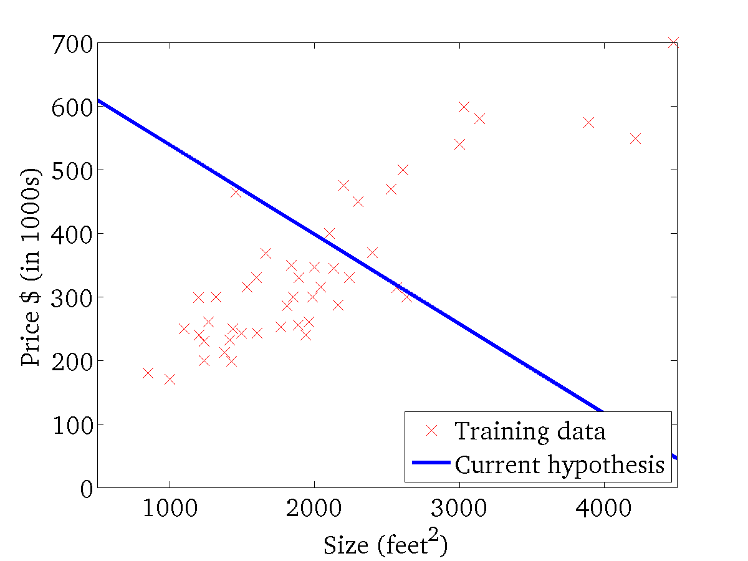

(for fixed , this is a function of x)
(function of the parameters )

Slide 75


(for fixed , this is a function of x)
(function of the parameters )

Slide 76

(for fixed , this is a function of x)
(function of the parameters )

Slide 77

(for fixed , this is a function of x)
(function of the parameters )

Slide 78


(for fixed , this is a function of x)
(function of the parameters )

Slide 79

(for fixed , this is a function of x)
(function of the parameters )

Slide 80


(for fixed , this is a function of x)
(function of the parameters )

Slide 81
多变量线性回归
多个特征
Multiple features
Machine Learning

Slide 82



Multiple features多个特征(variables变量).
Size (feet²) | Price ($1000)
2104 | 460
1416 | 232
1534 | 315
852 | 178
… | …

Slide 83
Multiple features多特征 (variables变量).
Size (feet²) | Number of bedrooms | Number of floors | Age of home (years) | Price ($1000)
2104 | 5 | 1 | 45 | 460
1416 | 3 | 2 | 40 | 232
1534 | 3 | 2 | 30 | 315
852 | 2 | 1 | 36 | 178
… | … | … | … | …

Slide 84



Multiple features多特征 (variables变量).
Size (feet²) | Number of bedrooms | Number of floors | Age of home (years) | Price ($1000)
2104 | 5 | 1 | 45 | 460
1416 | 3 | 2 | 40 | 232
1534 | 3 | 2 | 30 | 315
852 | 2 | 1 | 36 | 178
… | … | … | … | …
Notation:
= number of features
= input (features) of training example.
= value of feature in training example.
Notes:
Pop-up Quiz

Slide 85
假设函数Hypothesis:
Previously之前:

Slide 86

假设函数
为了方便, 定义哑元变量
Multivariate linear regression多变量线性回归.

Slide 87
多变量线性回归的梯度下降
多变量线性回归
Machine Learning

Slide 88




假设Hypothesis:
参数Parameters:
代价函数Cost function:
梯度下降Gradient descent:
Repeat
(同时更新 for every )

Slide 89











新算法:
梯度下降Gradient Descent
Repeat
Previously (n=1):
Repeat
(simultaneously update for
)
(simultaneously update )

Slide 90
梯度下降实践I: 特征缩放Feature Scaling
多变量线性回归
Machine Learning
机器学习

Slide 91







特征缩放Feature Scaling
Idea: Make sure features are on a similar scale 使特征有相似的尺度.
E.g. = size (0-2000 feet²)
= number of bedrooms (1-5)
size (feet²)
number of bedrooms

Slide 92

Feature Scaling特征缩放
使每一个特征的取值范围大约限定在 .

Slide 93





Mean normalization均值归一化
用 替换 ，使特征近似地具有零均值 zero mean (不适用于Do not apply to ).
E.g.

Slide 94
Gradient descent in practice II: Learning rate
多变量线性回归Linear Regression with multiple variables
Machine Learning

Slide 95


Gradient descent梯度下降
“Debugging”调试: How to make sure gradient descent is working correctly如何使梯度下降正确工作.
How to choose learning rate .

Slide 96


Making sure gradient descent is working correctly.确保梯度下降正确工作
Example automatic convergence test收敛性测试:
Declare convergence if decreases by less than in one iteration.
No. of iterations

Slide 97



Making sure gradient descent is working correctly.
Gradient descent not working.
Use smaller .
No. of iterations
No. of iterations
No. of iterations
For sufficiently small , should decrease on every iteration.
But if is too small, gradient descent can be slow to converge.

Slide 98
Summary:
If is too small: slow convergence.
If is too large: may not decrease on every iteration; may not converge.
To choose , try

Slide 99
特征与多项式回归Features and polynomial regression
多变量线性回归Linear Regression with multiple variables
Machine Learning

Slide 100

Housing prices prediction房屋价格预测

Slide 101





Polynomial regression多项式回归
Price
(y)
Size (x)

Slide 102
Choice of features
Price
(y)
Size (x)

Slide 103
分类Classification
逻辑回归
（Logistic Regression）
Machine Learning

Slide 104

Classification分类
Email: Spam垃圾 / Not Spam?
Online Transactions在线交易: 欺诈的Fraudulent (Yes / No)?
Tumor肿瘤: Malignant恶性的/ Benign良性的 ?
0: “Negative Class负类” (e.g., 良性的benign tumor)
1: “Positive Class正类” (e.g.,恶性的malignant tumor)

Slide 105


(Yes) 1
Malignant ?
(No) 0
Tumor Size
Tumor Size
Threshold classifier output阈值分类器输出 at 0.5:
If , predict预测 “y = 1”
If , predict预测 “y = 0”

Slide 106
(Yes) 1
Malignant ?
(No) 0
Tumor Size
Tumor Size
Threshold classifier output at 0.5:
If , predict “y = 1”
If , predict “y = 0”

Slide 107


Classification分类: y = 0 or 1
线性回归的
can be > 1 or < 0
Logistic Regression逻辑回归:

Slide 108
假设表示Hypothesis Representation
逻辑回归
Logistic Regression
Machine Learning

Slide 109


逻辑回归模型Logistic Regression Model
Want
z = θ^{T}x
1
0.5
Sigmoid function函数g(z)
Logistic function函数g(z)
0
参数向量

Slide 110



假设输出的解释Interpretation of Hypothesis Output
= estimated probability that y = 1 on input x
Example: If
告诉病人肿瘤是恶性的可能性为70%
“probability that y = 1, given x,
parameterized by ”

Slide 111
决策边界 Decision boundary
Logistic Regression
逻辑回归
Machine Learning

Slide 112







Logistic regression逻辑回归
1
z
Suppose predict “ “ if
predict “ “ if

Slide 113


Decision Boundary决策边界
x₂
3
2
1
1
2
3
x₁
Predict “ “ if

Slide 114
Decision Boundar决策边界
x₂
3
2
1
1
2
3
x₁
Predict “ “ if

Slide 115


非线性决策边界Non-linear decision boundaries
x₂
1
x₁
-1
1
-1
Predict “ “ if

Slide 116
非线性决策边界Non-linear decision boundaries
x₂
1
x₁
-1
1
-1
Predict “ “ if
x₂
x₁

Slide 117
回顾：线性回归
假设
(Hypothesis):
Parameters参数:
Cost Function
代价函数:
Goal目标:

Slide 118
Gradient descent algorithm
Linear Regression Model

Slide 119
逻辑回归模型Logistic Regression Model
Want
z = θ^{T}x
1
0.5
Sigmoid function函数g(z)
Logistic function函数g(z)
0
参数向量

Slide 120
代价函数 Cost function
逻辑回归
Machine Learning

Slide 121




Training set训练集:
m examples示例
如何选择参数 ？
How to choose parameters ?

Slide 122


Cost function代价函数
Linear regression:
线性回归
非凸“non-convex”
凸“convex”

Slide 123
Cost function代价函数
Linear regression:
逻辑回归
非凸“non-convex”
凸“convex”

Slide 124


Logistic regression cost function逻辑回归代价函数
If y = 1
使用非常大的代价来惩罚学习算法
0
1

Slide 125
Logistic regression cost function逻辑回归代价函数
If y = 0
0
1

Slide 126
简化的代价函数 与梯度下降
Logistic Regression
逻辑回归
Machine Learning

Slide 127

逻辑回归代价函数Logistic regression cost function

Slide 128


逻辑回归代价函数Logistic regression cost function
拟合参数To fit parameters :
预测新的测试例子的类别To make a prediction given new :
Output

Slide 129


逻辑回归的梯度下降Gradient Descent
Want :
Repeat
(simultaneously update all )

Slide 130

逻辑回归的梯度下降Gradient Descent
Want :
Repeat
(simultaneously update all )
Algorithm looks identical to linear regression!

Slide 131
逻辑回归的梯度下降Gradient Descent
Want :
Repeat
(simultaneously update all )
Algorithm looks identical to linear regression!
看起来与线性回归的一样！

Slide 132
Advanced optimization 高级优化
Logistic Regression逻辑回归
Machine Learning

Slide 133


Optimization algorithm优化算法
Cost function . Want .
Given , we have code that can compute
(for )
Gradient descent:
Repeat

Slide 134
Optimization algorithm
Given , we have code that can compute
(for )
Optimization algorithms:
Gradient descent
Advantages:
No need to manually pick
Often faster than gradient descent.
Disadvantages:
More complex
Conjugate gradient
BFGS
L-BFGS

Slide 135



Example:
function [jVal, gradient] = costFunction(theta)
jVal = (theta(1)-5)^2 + ... (theta(2)-5)^2;
gradient = zeros(2,1);
gradient(1) = 2*(theta(1)-5); gradient(2) = 2*(theta(2)-5);
options = optimset(‘GradObj’, ‘on’, ‘MaxIter’, ‘100’);
initialTheta = zeros(2,1); [optTheta, functionVal, exitFlag] ...
= fminunc(@costFunction, initialTheta, options);

Slide 136




theta =
function [jVal, gradient] = costFunction(theta)
code to compute
jVal = [ ];
code to compute
gradient(1) = [ ];
code to compute
gradient(2) = [ ];
code to compute
gradient(n+1) = [ ];

Slide 137
多类分类 Multi-class classification: One-vs-all
逻辑回归
Logistic Regression
Machine Learning

Slide 138
多类分类Multiclass classification
Email foldering/tagging标签: Work, Friends, Family, Hobby
Medical diagrams: Not ill, Cold感冒, Flu流感
Weather: Sunny, Cloudy, Rain, Snow

Slide 139
Binary classification二分类:
Multi-class classification多类分类:
x₂
x₂
x₁
x₁

Slide 140


x₂
一对多One-vs-all (one-vs-rest):
x₁
x₂
x₂
x₁
x₁
Class 1:
Class 2:
Class 3:
x₂
x₁

Slide 141





One-vs-all一对多
Train a logistic regression classifier for each class to predict the probability that .
On a new input , to make a prediction, pick the class that maximizes

Slide 142
过拟合问题 The problem of overfitting
正则化Regularization
Machine Learning

Slide 143


Example: Linear regression线性回归 (housing prices房价)
Price
Price
Price
Size
Size
Size
Overfitting过拟合: 如果特征过多,学习的假设函数hypothesis 可能在训练集上拟合得太好 ( ), 但是不能很好地泛化到新样本上 (predict prices on new examples).

Slide 144


Example: Logistic regression逻辑回归
x₂
x₂
x₂
x₁
x₁
x₁
( = sigmoid function)

Slide 145







Addressing overfitting解决过拟合:
size of house
no. of bedrooms
Price
no. of floors
age of house
average income in neighborhood
Size
kitchen size

Slide 146

Addressing overfitting解决过拟合:
Options选项:
Reduce number of features减少特征数目.
Manually select which features to keep.
Model selection algorithm 模型选择算法(later in course).
Regularization正则化.
Keep all the features, but reduce magnitude/values of parameters .但减少参数的大小/值
Works well when we have a lot of features, each of which contributes a bit to predicting .

Slide 147
代价函数 Cost function
正则化Regularization
机器学习
Machine Learning

Slide 148



Intuition
Price
Price
Size of house
Size of house
Suppose we penalize 惩罚and make , really small.

Slide 149



Regularization正则化.
Small values for parameters
“Simpler” hypothesis简化假设
Less prone to overfitting 不容易过拟合
Housing:
Features:
Parameters:

Slide 150


Regularization正则化
正则化参数
Price
Size of house

Slide 151

正则化线性回归,我们选择最小化 minimize
What if is set to an extremely large value (perhaps for too large for our problem, say )?
Algorithm works fine; setting to be very large can’t hurt it
Algortihm fails to eliminate overfitting.
Algorithm results in underfitting. (Fails to fit even training data well).
Gradient descent will fail to converge.

Slide 152
正则化线性回归,我们选择最小化minimize
正则化参数
What if is set to an 非常大的值(perhaps for too large for our problem, say )?
Price
Size of house

Slide 153
Regularized linear regression 正则化线性回归
Regularization
正则化
Machine Learning

Slide 154

Regularized linear regression正则化线性回归

Slide 155





Gradient descent梯度下降
Repeat

Slide 156


Normal equation

Slide 157




Non-invertibility (optional/advanced).
Suppose ,
(#examples) (#features)
If ,

Slide 158
Regularized logistic regression 正则化逻辑回归
Regularization
正则化
Machine Learning

Slide 159



Regularized logistic regression正则化逻辑回归.
x₂
x₁
Cost function代价函数:

Slide 160
Gradient descent梯度下降
Repeat

Slide 161








Advanced optimization
function [jVal, gradient] = costFunction(theta)
code to compute
jVal = [ ];
code to compute
gradient(1) = [ ];
code to compute
gradient(2) = [ ];
code to compute
gradient(3) = [ ];
code to compute
gradient(n+1) = [ ];

Slide 162
非监督学习介绍Unsupervised learning introduction
聚类Clustering
Machine Learning

Slide 163


监督学习Supervised learning
Training set:

Slide 164

非监督学习Unsupervised learning
Training set:

Slide 165


聚类的应用Applications of clustering
Market segmentation
Social network analysis
Image credit: NASA/JPL-Caltech/E. Churchwell (Univ. of Wisconsin, Madison)
Organize computing clusters
Astronomical data analysis
Notes:
Swap: market seg and organize clusters

Slide 166
K-means algorithm
聚类Clustering
Machine Learning

Slide 167


Slide 168


Slide 169


Slide 170


Slide 171


Slide 172


Slide 173


Slide 174
Notes:
Get rid of the legacy points

Slide 175
Notes:
Get rid of the legacy points

Slide 176




K均值算法K-means algorithm
Input:
(number of clusters)
Training set
(drop convention)

Slide 177





K-means algorithm（K均值算法）
Randomly initialize cluster centroids
Repeat {
for = 1 to
:= index (from 1 to ) of cluster centroid
closest to
for = 1 to
:= average (mean) of points assigned to cluster
}
Notes:
Replace with normal text, size with LATEX fonts

Slide 178
K-means for non-separated clusters 非分离的簇
T-shirt sizing
Weight
Height

Slide 179
优化目标 Optimization objective
聚类Clustering
Machine Learning

Slide 180






K-means optimization objective （K均值聚类算法优化目标）
= index of cluster (1,2,…, ) to which example is currently assigned每个示例当前分派的簇编号
= cluster centroid ( ) 簇中心
= cluster centroid of cluster to which example has been assigned
Optimization objective优化目标:
Notes:
Change numbers to LATEX as well

Slide 181


K-means algorithm（K均值算法）
Randomly initialize cluster centroids中心
Repeat {
for = 1 to
:= index (from 1 to ) of cluster centroid
closest to
for = 1 to
:= average (mean) of points assigned to cluster
}
Notes:
Replace as previous; change spacing to fill page

Slide 182
Random initialization
Clustering
Machine Learning

Slide 183
K-means algorithm
Randomly initialize cluster centroids
Repeat {
for = 1 to
:= index (from 1 to ) of cluster centroid
closest to
for = 1 to
:= average (mean) of points assigned to cluster
}
Notes:
Replace as previous; change spacing to fill page

Slide 184


Random initialization
Should have
Randomly pick training
examples.
Set equal to these
examples.
Notes:
LATEX font

Slide 185
Local optima

Slide 186


Random initialization
For i = 1 to 100 {
Randomly initialize K-means.
Run K-means. Get .
Compute cost function (distortion)
}
Pick clustering that gave lowest cost

Slide 187
Choosing the number of clusters
Clustering
Machine Learning

Slide 188
What is the right value of K?

Slide 189

Choosing the value of K
Elbow method:
Cost function
Cost function
(no. of clusters)
(no. of clusters)

Slide 190
Choosing the value of K
Sometimes, you’re running K-means to get clusters to use for some later/downstream purpose. Evaluate K-means based on a metric for how well it performs for that later purpose.
E.g.
T-shirt sizing
T-shirt sizing
Weight
Weight
Height
Height

Slide 191
10.2 几种基本判别模型的学习
10.2.1 回归问题的线性函数模型学习，梯度下降法
设有样本数据如下表所示：
它们所构成的数据点在x-y空间中的分布如图10-1所示。

Slide 193
设
作为评价学习效果的准则函数，称为误差函数。再设定一个ε >0，作为误差函数值E(a, b)的上限。那么，
E(a, b)< ε (10-2)
就是我们的评价准则。
用误差函数E(a, b)在点(a, b)的负梯度
来引导搜索，即确定当前点(a, b)的下一个点(a’, b’)的所在方向和位置。
用梯度引导函数极小值点的搜索，就是著名的梯度下降法（gradient descent，亦称最速下降法）。

Slide 194
由矢量代数知识和梯度下降法原理，在搜索过程中点(a, b)的变换公式亦即系数a, b取值的修正公式为
(a, b)= (a, b) −η∇E(a, b) (10-4)
其中0<η≤1，称为学习因子或学习率，用以控制搜索时的移动步长亦即参数值修正量的大小。(10-4)式是用向量表示的修正公式，写成分量形式则为

Slide 195
一个学习相应线性函数的算法：
—————————————————————————
(1) 设定一个η值和一个误差上限ε；
(2) 给系数变量a, b各赋一个初值；
(3) 将样本集中变量x_{i}的取值依次代入函数式ax+b求相应的y值，并计算总误差
E(a, b)=
(4) 如果E(a, b)<ε，则当前的a、b取值即为所求，于是，算法结束；否则，计算梯度∇E(a, b)，修正a、b的取值，即令
(a, b)= (a, b) −η∇E(a, b)；
然后转(3)
—————————————————————————

Slide 196
假设经机器学习，系数a, b分别取1.95和−0.96。于是，得线性函数
y=1.95x−0.96
相应的函数图像如图10-2所示。

Slide 197
说明：
梯度下降法的缺点是容易陷入局部极小点。另外，对于大规模数据，这种步进式的搜索其效率也是个问题。为此，人们又开发出了随机梯度下降法。
上面关于一元线性函数的学习算法也可推广到多元线性函数的学习中去。

Slide 198
10.2.2 分类问题的线性判别函数模型学习
设有下列样本数据：
其中，y=f(x₁, x₂)是一个指示函数，y为(x₁, x₂)所属类别的标记，取值为0和1。

Slide 199
考虑在类1和类0（分别记为C₀和C₁）之间构造一条直线：
w₀+w₁x₁+w₂x₂=0 (10-7)
这里，x₁、x₂为变量，w₁、w₂系数，w₀为常数。
令 g(x) = g(x₁, x₂) =w₀+w₁x₁+w₂x₂，则对于点x∈U×V⊆R²
当g(x)<0时，则x∈c₀；
当g(x)>0时，则x∈c₁
这样，参数w₀、w₁、w₂取值未定的函数
g(x)= w₀+w₁x₁+w₂x₂
就是这个分类问题的假设判别函数模型。g(x)是一个线性函数，称为线性判别函数。

Slide 201
为了叙述方便，将函数式w₀+w₁x₁+w₂x₂写成系数向量与变元向量的内积的形式，即
这里参数w₁、w₂称为权值，表示在函数中的重要程度，w₀称为阈值权或偏置（bias，亦称偏差或偏倚）。
如果引入x₀=1，则上面的函数式可进一步写成
原直线方程也就变为
w^{T}x_{i}=0 (10-8)

Slide 202
一个简单的学习算法：
——————————————————————————---———————————
(1) 初始化权向量w，并设置一个合适的学习率η∈(0, 1]；
(2) 对训练样例(x_{i}, y_{i}) (i=1,2,…,n)：
计算 w^{T}x_{i}；
如果w^{T}x_{i}>0，令h_{i}=1，否则h_{i}=0；
更新权值：w= w+η (h_{i}− y_{i}) x_{i}。
(3) 直到对所有训练样例都有h_{i} − y_{i}=0，则当前权向量w即为所求，学习结束；
否则转(2)。
—————————————------————————————————————————

Slide 203
经过机器学习，权向量w的值被确定后，判别函数 g(x)= w^{T}x也就确定了。于是，进一步就有分类判决规则：
对于任一x∈U×V，
如果g(x)>0，则x∈C₁；
如果g(x)<0，则x∈C₀；
如果g(x)=0，则根据实际问题进行分类或不予分类。
上述判别函数和判决规则就构成了一个“分类器”，或线性分类器。现在，就可用这个分类器对相关的对象进行分类了。

Slide 204
说明：
• 这里的判别函数g(x)完全可以推广为n元线性函数。从而这个分类器也就被推广为n维线性分类器。
• 上面的学习算法是针对线性可分的样本集的，相应的分类器也是针对线性可分问题的。
• 上面的算法中没有使用准则函数。但实际上，对于线性判别函数的学习，人们已开发了许多准则函数。
• 线性判别函数不仅可用于二分类问题，也可用于多分类问题。

Slide 205
10.2.3 分类问题的Logistic回归模型学习，梯度上升法
♦ Logistic函数（也称Sigmoid函数）

Slide 206
取变换
y= w₀+w₁x₁+w₂x₂= (w₀, w₁, w₂)^{T}•(1, x₁, x₂)=W^{T}x
得
将函数Logistic(x)作为分类问题的一种假设概率模型而表示为：
这两个等式称为二项Logistic回归模型的条件概率分布。

Slide 207
从式(10-11)可以看出，当W^{T}x的值越接近正无穷，概率值P(Y=1 | x)就越接近1；当W^{T}x的值越接近负无穷，概率值P(Y=1 | x)就越接近0.
由式(10-10)和式(10-11)，有
现在，考虑如何确定式(10-11)中参数W^{T}=(w₀,w₁,w₂)的值？

Slide 208
将对数据x的一次分类决策的损失定义为：
这一函数称为负对数似然函数。如果将这里的y值0、1当作数值来用，则上面的两个表达式也可合并为：
l(W, x)= −yln(g(x; W)) − (1−y)ln(1−g(x; W)) (10-15)
将全部n个样本在参数W下的损失相加，得
这就是我们给出的准则函数，可称为损失函数（或误差函数、代价函数等），也是一种交叉熵（cross-entropy）。

Slide 209
有了这个损失函数L(W)，机器就可在其指导和约束下，通过反复计算-修正操作而最终找到最佳参数值W*。于是，也就找到了最佳模型g(x; W*)。参数W的值确定后，上面的式(10-11)和(10-12)就正式成为上面分类问题的两个判别函数了。由于是二分类问题而且P(Y=0 | x)=1− P(Y=1|x)，C₁的判别函数就可以作为C₁ 和C₀两个类的判别函数。于是有分类判决规则：
对于任一x∈U×V，
如果P(Y=0 | x)≥0.5，则x∈C₁；
否则，则x∈C₀。

Slide 212
Logistic回归的随机梯度上升算法

Slide 213
10.3 监督学习中几个进一步的问题
10.3.1 监督学习的主要工作及步骤
1. 数据准备
即收集样本数据，然后从中选取一部分作为训练样本，另一部分作为测试样本，或者再取一部分样本作为训练后的一个验证集。
2. 选择或设计假设模型
就是根据样本数据和实际问题的特点，选择或设计拟学习的数学表达式，一般为某种数值函数（Y=f(X)）或条件概率分布（P(Y⎪X)）。假设模型实际是模型类，因为表达式的参数未取值。

Slide 214
3. 选择或设计准则函数
准则函数是一种可量化相关评价指标的函数。常用的准则函数有误差函数、损失函数、代价函数、风险函数等。
4. 选择或设计学习策略和算法
学习策略包括准则函数选择、搜索方式（如步进搜索、随机搜索）、搜索方向（如梯度下降、梯度上升）、搜索
起点（即参数初值）、搜索步长（即学习因子或学习率）等。策略确定后，就选择或设计相应的算法。
5. 编程实现
就是选择合适的语言、工具或平台，编制程序，实现算法，进行相应的学习训练和测试。

Slide 215
10.3.2 准则函数的演变
♦在准则函数中，常用的损失函数有0-1损失函数、平方损失函数、绝对损失函数和对数损失函数等。
♦损失函数的期望：
♦经验风险（empirical risk）：
♦结构风险（structural risk）

Slide 216
10.3.3 过拟合，欠拟合，正则化
♦泛化（generalization）能力。是指由该方法所学得的模型对新数据的预测或分类能力。
♦过拟合（over-fitting）。就是学习所得模型对训练数据分类或预测得很好，但对新数据却很差。
♦欠拟合（under-fitting）。就是学习所得模型对数据的分类和预测能力很差。
♦偏差（bias，亦称偏倚）和方差（variance）。可以对过拟合和欠拟合进行定量分析的两种测度。

Slide 217
♦正则化（regularization）方法。
为了避免过拟合和欠拟合，人们采用正则化（regularization）方法，即给模型再设计一个测度函数来评估模型的复杂度。
♦泛化误差（generalization error）：
泛化误差反映了学习方法的泛化能力。

Slide 218

10.3.4 模型与学习方法的分类
♦生成模型（generative model）
♦判别模型（discriminative model）
♦生成方法（generative approach）
♦判别方法（discriminative approach）
生成模型由生成方法（generative approach）所得，判别模型则由判别方法（discriminative approach）所得。生成方法先由数据学习联合概率分布P(Y, X)，然后求出概率分布
P(Y⎪X)= (10-27)
作为预测模型，即生成模型。

Slide 219
典型的生成模型有朴素贝叶斯法中的分类模型、由最大似然估计和贝叶斯估计所得的分类模型以及隐马尔科夫模型（Hidden Markov Model, HMM）等。判别方法由数据直接学习判别函数Y=f(X)或者条件概率分布P(Y⎪X)作为预测模型，即判别模型。典型的判别模型有：k-近邻法、线性判别函数、决策树、逻辑斯谛回归模型、最大熵模型、支持向量机、提升方法和条件随机场等。

Slide 220
10.4 支持向量机简介
10.4.1 最大间隔超平面
能使两侧数据子集的边界点到其的距离都达到最远，即能以最大间隔分隔两个数据子集的超平面称为最大间隔超平面。

Slide 221
10.4.2 线性可分支持向量机
设有线性可分的训练样本集S= ，y_{i}∈{+1,−1}分别对应正类样本和负类样本。
设分隔数据点集D= 成为两个子集的超平面方程为
w^{T}x_{i} +b=0 (10-28)
首先，这个超平面要能够正确分类数据点集D，所以它必须满足下面两个不等式：
w^{T}x_{i} +b≥0, 对于正类样本
w^{T}x_{i} +b<0, 对于负类样本
如果将y_{i}的取值作为数值与w^{T}x_{i} +b相乘，则这两个不等式可以统一为
y_{i} (w^{T}x_{i} +b)≥0 (10-29)

Slide 226
现在，将所得的w*和b*代入(10-28)式，就得到了所求的最大间隔超平面：
w*^{T}x_{i} +b*=0 (10-38)
从而，也就得到了一个线性判别函数f(w*^{T}x_{i} +b*)。

Slide 227
10.4.3 线性支持向量机和非线性支持向量机
1. 线性支持向量机
线性支持向量机的具体做法是：在上面(10-32)和(10-33)式的基础上引入一个所称的松弛变量ξ_{i}≥0和一个惩罚参数C>0，使得求相应最佳分类超平面的问题变为求解如下的凸二次规划问题：

Slide 229
2. 非线性支持向量机

Slide 232
延伸学习导引
• 本章主要介绍了分类问题的相关学习模型和算法，包括线性判别函数模型学习、Logistic回归模型学习和支持向量机。此外，关于分类问题还有非线性判别函数模型、最近邻算法、决策树（9.3节已介绍过）等有待延伸学习。另外，朴素贝叶斯分类算法被安排在第13章（见13.3节）。
• 本章仅介绍了一个关于回归问题的学习模型和算法——一元线性函数模型学习。显然，除了一元线性模型外，还有多元线性模型学习。进而，还有非线性模型，最常用的则是多项式函数模型。
• 本章介绍的学习模型和算法属于判别模型和判别方法，而生成模型和生成方法被安排在第13章介绍（参见13.3和13.4节）。除该章介绍的外，典型的判别模型还有：k-近邻法、决策树和随机森林、最大熵模型、提升方法和条件随机场等。

Slide 233
• 本章介绍的都属于参数方法，而非参数方法中的最近邻算法和插值方法有待延伸学习。
• 本章介绍的学习方法均为监督学习，对于非监督学习（亦即聚类问题），将在第12章中介绍（见12.4节）。但也只介绍了k-均值聚类算法。此外，非监督学习还有许多经典算法，如：期望最大化算法、谱聚类算法和层次聚类算法等等。
• 本章介绍的线性判别函数模型和支持向量机属于数值路线的方法。在这一方向上有待延伸学习的还有非线性判别函数模型，多分类判别函数模型、非线性支持向量机、多分类支持向量机、回归支持向量机以及VC维等有关技术和理论知识。

Slide 234
• 概率路线的方法本章仅介绍了Logistic回归模型的学习，在第13章中主要介绍一般的概率分类法、朴素贝叶斯法和最大似然估计等。但还有贝叶斯估计、贝叶斯学习和基于贝叶斯网络（亦称图模型，8.4节已介绍过）的图方法以及一种时间序列概率模型（一种动态贝叶斯网络）——隐马尔科夫模型等内容有待延伸学习。
• 若要对统计学习做更深入的学习和研究，则至少还要读Vapnik所著的《统计学习理论的本质》和《统计学习理论》两部专著。

Slide 235
作业
P237习题10
10-1
10-2
10-3

